Slide 1
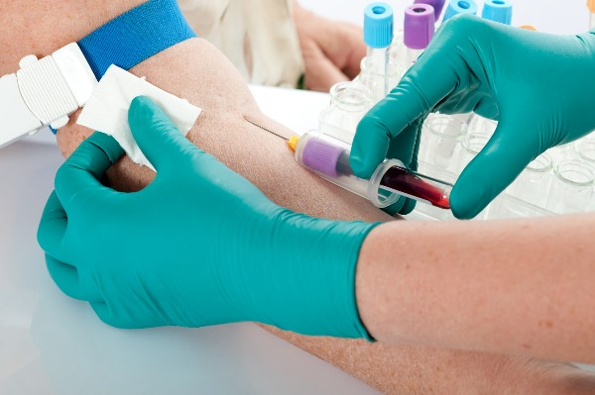
Phlebotomist

Slide 2
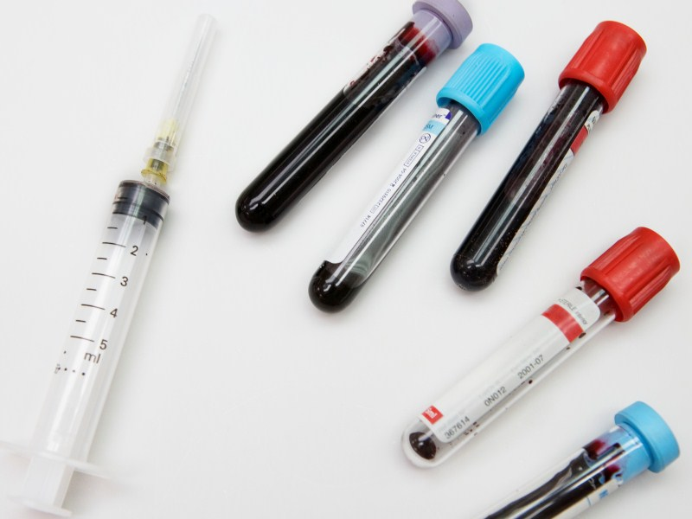
What I think a Phlebotomist is
I believe that a phlebotomist is a person who draws/ test blood.

Slide 3
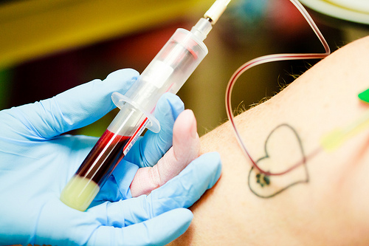
What a Phlebotomist really is
Medical professionals who draw blood from patients for various lab tests and procedures.
(Santiago,2016)

Slide 4
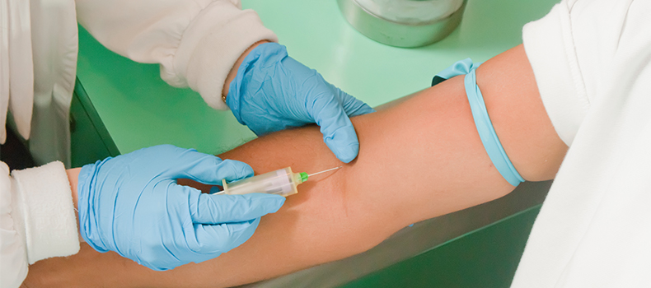
The education required to be a phlebotomist
Completion of a certificate or diploma program
Completion of a training program will help make your chances of getting the job much higher
(Education,2016)

Slide 5
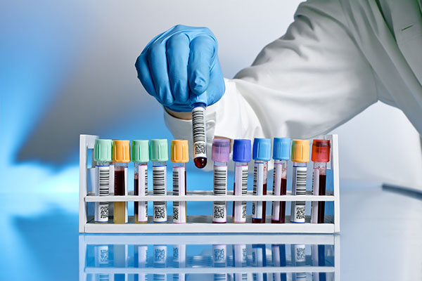
What college classes do you need to take
Physiology, equipment technique, procedures, and terminology of the profession
(Education,2016)

Slide 6
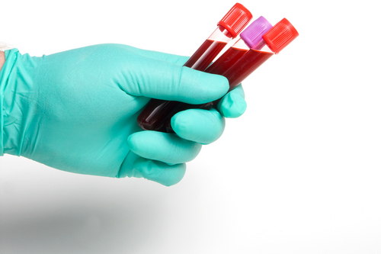
Duties & Responsibilities of a phlebotomist
Draw blood from patients,collect blood specimens using a variety of methods, like venipuncture, dermal puncture or artery collection, explain the collection process and help ease a patient's nerves the best you can, and follow strict precautionary safety procedures
(Learn,2003)

Slide 7
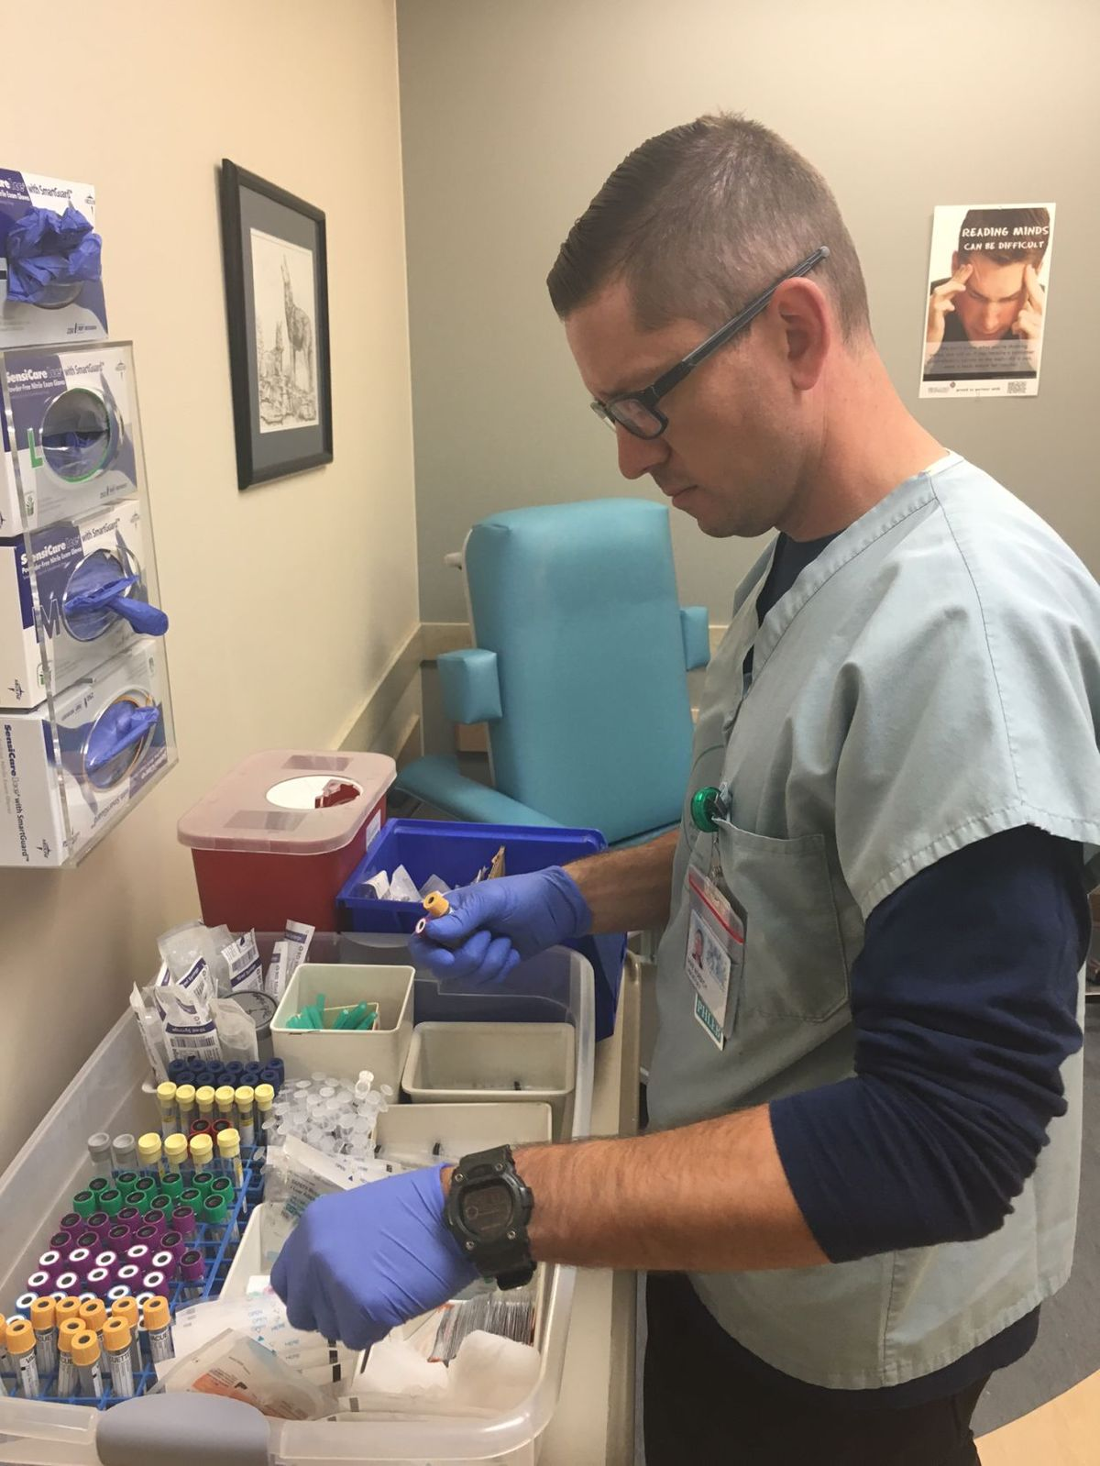
Where can you find a Phlebotomist
Phlebotomists work in clinical laboratories, hospitals, community health centers, nursing homes, doctors offices, blood donation centers and other health care facilities.
(Health,2017)

Slide 8
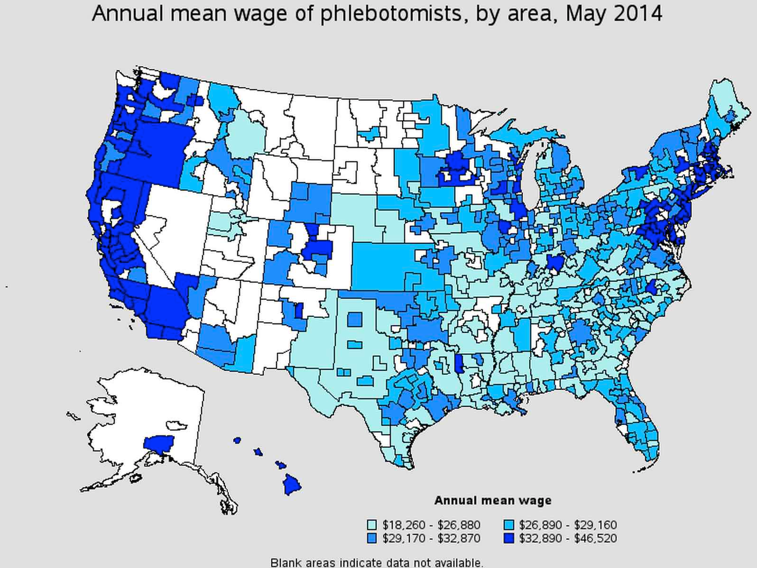
Phlebotomist salary
The median amount a phlebotomist makes is $32,230, but their salary can range anywhere from$29,034-$36,003.
(Salary,2017)

Slide 9
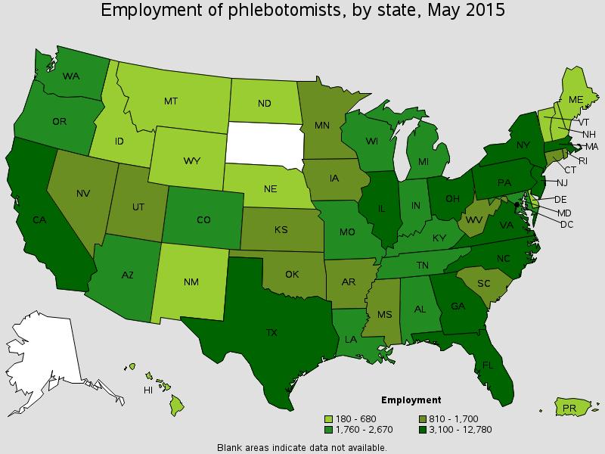
Job outlook for Phlebotomist
Employment of phlebotomists is projected to grow 25 percent from 2014 to 2024, much faster than the average for all occupations. Hospitals, diagnostic laboratories, blood donor centers, and other locations will need phlebotomists to perform bloodwork.
(Bureau of labor stats,2017)

Slide 10
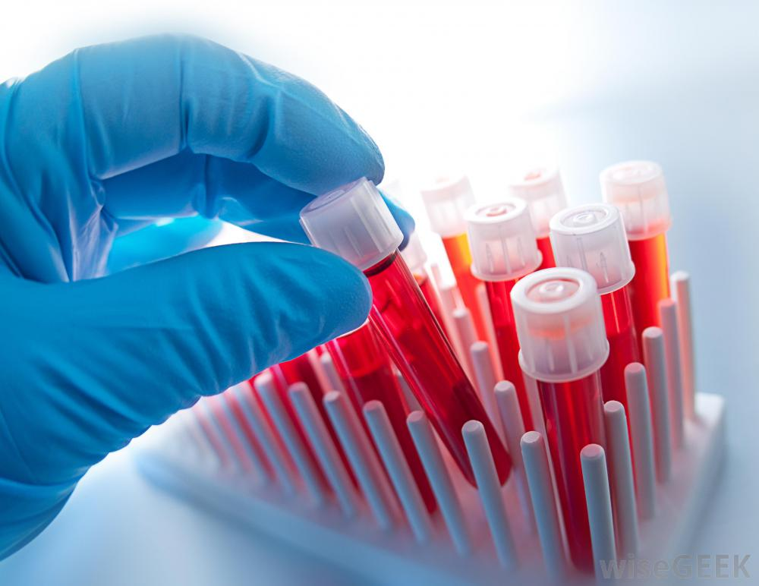
Typical day of a Phlebotomist
Phlebotomists draw blood for tests, transfusions, donations, or research. May explain the procedure to patients and assist in the recovery of patients with adverse reactions.
(Phlebotomist,2017)

Slide 11
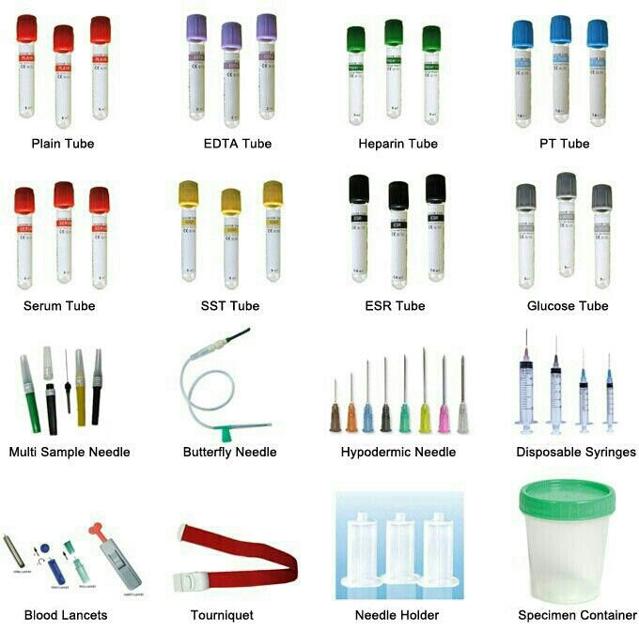
Skills needed to be a Phlebotomist
Good written and spoken communication skills
Empathy, with the ability to put nervous and distressed patients at ease
Practical skills and a steady hand
The ability to follow instructions and procedures accurately
The ability to work calmly under pressure
(National,2017)

Slide 12
Interesting things about Phlebotomist
Deal with patients hands on
Phlebotomy courses can be completed in as small as 1 month
A phlebotomist salary is quite high for an entry level salary
(Phlebotomy,2017)

Slide 13
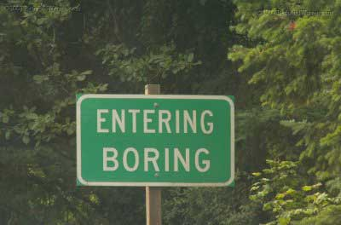
Things I found uninteresting/bad about Phlebotomy
You're doing the same thing over and over again each day
The salary isn’t that great

Slide 14
Is Phlebotomy for me?
Personally the only thing that interests me about phlebotomy is that you don’t have to do much schooling. Other than that I feel that phlebotomy is pretty boring. You work hard everyday and personally I feel that you aren’t earning what you deserve. So no phlebotomy is not for me.

Slide 15
H. (n.d.). Find Out if a Phlebotomy Job Is Right For You. Retrieved February 09, 2017, from https://www.verywell.com/what-is-a-phlebotomist-1736261
Overview of Phlebotomy Degrees. (n.d.). Retrieved February 09, 2017, from http://www.collegesanddegrees.com/programs/phlebotomy
What Are the Duties of a Phlebotomist? (n.d.). Retrieved February 09, 2017, from http://learn.org/articles/What_Are_the_Duties_of_a_Phlebotomist.html
Phlebotomist. (n.d.). Retrieved February 09, 2017, from https://explorehealthcareers.org/career/allied-health-professions/phlebotomist/

Slide 16
Salary.com, S. B. (n.d.). Phlebotomist Salaries. Retrieved February 09, 2017, from http://www1.salary.com/Phlebotomist-Salary.html
Summary. (n.d.). Retrieved February 09, 2017, from https://www.bls.gov/ooh/healthcare/phlebotomists.htm
H. (2016, May 31). Being A Phlebotomist: What You Really Do. Retrieved February 09, 2017, from http://www.owlguru.com/career/phlebotomists/job-description/

